Slide 1
MPCA Mini Project
Project Title : Google assistant home automation using arduino
Section : 4 – ‘B’
Students Name : Mukthi Prada.G.M , Supriya.R , Swathi Tripathi
SRN : PES2201800310 , PES2201800270 , PES2UG19CS807

Slide 2
Problem Statement
The main objective of this project is to build a smart home device which can be used to control the electronic home appliance via Google Assistant. The home automation device which we build can be integrated with almost all the electronic appliances or gadgets and can be used to control them remotely from any part of the world.
To facilitate the wireless connectivity with the system, the microcontroller will be embedded with a Wi-Fi module. This now establish the internet connection to the system and all the appliances can in turn be connected and controlled over the internet.

Slide 3
Introduction
Comfort is becoming a major priority in the 21st century. So the revolutions of computing and smart environment came into existence. Some technologies like Ubiquitous/pervasive and ambient intelligence satisfy the maximum need of smart world but these technologies are not tightly coupled with the internet, so the people need another technology extension. Internet of Things (IoT) is an ideal buzzing technology to influence the internet and communication technologies. IoT allows people and things to be connected anytime, anyplace, with anything and anyone, by using ideally in any path/network and any service. Home automation system achieved great popularity in the last decades and it increases the quality of life. In addition to this in this project to make the facilities more user friendly we use Google assistant as an interface between the user and interconnected things.

Slide 4
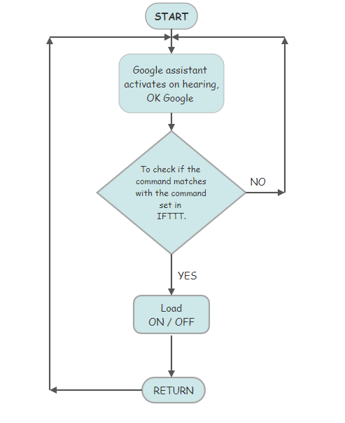
Block Diagram/Circuit Diagram

Slide 5
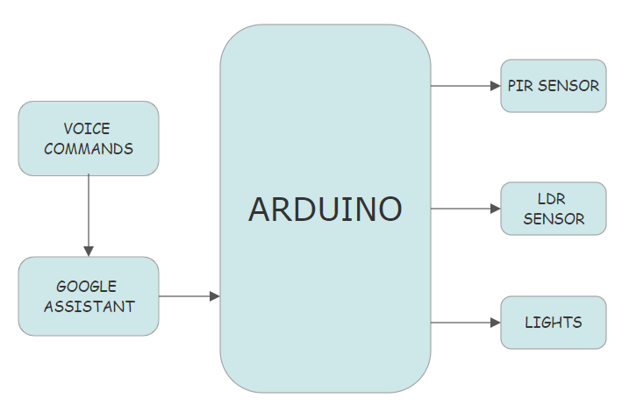

Slide 6
Required Components
Arduino Uno,
PIR Motion sensor,
LDR (Light Dependent Resistor)sensor,
LED’s,
Jumper wires
Bread Board

Slide 7
Project Explanation
Our project is focused on automating the lighting facilities of the house. The PIR Motion sensor used detects any motion in the area of the light source and turns on the light when a motion is detected. But if there is already lot of light around and a motion is detected there is no necessity for the light to turn on. To fulfil this condition we use LDR sensor which detects the light in that area and decides if light is to be turned or not. In addition to this we have facilitated an option of turning on and off the light using Google assistant from the owners smart phone.

Slide 8
Application
Our project mainly focuses on smart use of electricity.
The turning on and off of light can also be personalised from a distant place away from the light source.

Slide 9
Thank You

